Slide 1
A Unified Solution For Complete Computerization For School, College & Universities
college-software.dataman.in

Slide 2
Dataman Introduction
Academic Management Focus
Dataman Intro
Single Platform For School , Colleges & Institutions.
More than Decade of operations.
Focused on Complete Digitalized Solution For School, College & Universities.
Portal provides function & features for facilitating access to information & services that are of primary relevance and interests to the users.
Currently 100000+ users on Platform.
Team size of 110+ Team.
Online Portal Software
Global Presence
More than 40 Academics – ERP Customers in across India.
Our Clients :
- India
- Columbus, GA
- Dubai, UAE
- Thailand
- San Francisco, CA
Portal provide many useful services to students at a single place & through a single interface but in customized form.

Slide 3
Academics Management System
Teaching Management
Non – Teaching Management
Student & Parents Management
1
Management
Teacher
Class Room
2
Management
Staffs
Library
Accountant
3
Management
Parents / Student
Parents Meeting
Report Card

Slide 4
N-tier Academic Management Model
Students
This Online Web Portal will help the organization that has many Branch Schools / Colleges and a Super Admin can control all the branches and staff. Each branch will be controlled by Admin.
Librarian
Students
Teacher
Admin
Students
Super Admin
Parents
Students
Accountant

Slide 5
N-tier Academic Management Model
Manage All Admins Records
Manage All Teachers Records
Manage Parents Meeting, Fee Payment, Student Records And Student Report Details
Manage All Non-Teaching Records

Slide 6
Online Portal - Products & Solutions
Solution
Automate / Reduce Manual Processes
How To Manage ?
Solution
Managing All Data & Information
Solution
Reduce Time & Effort of Administrative Task
Manual Records
Solution
Accurate Reporting and Accessing Real-Time Data
College / University / School
Manage All Records
Perfect Solution !
Teacher
Parents /Student
Staff

Slide 7
Online Portal - Our Modules
Hostel & Transport Management System
Student Accounting & Fee Management
Online Homework Management System
Analytical Data Dashboard
Attendance Management System
Online Student Admission
Library Management System
Messaging Mailbox
Card Management
Payroll Management & Leave
Bulk Sms & Email
Exam Management
Live Class
Office Accounting

Slide 8
Online Portal - Our Modules
1
Student Accounting & Fees Management
2
Online Student Admission
Fees Allocation Class wise and Fees Customization for each student.
Fees Discounting Scheme can be applied according to student category.
Fees Reminder for Due fees via SMS & Email to Student with Schedule.
Automatic adding of Fine after Due Date.
Fee Payment By Online .Integration of Payment Gateway - Razorpay.
Admin Can Create Single & Multiple Student Fee Invoices.
The Fee Reports viewed in Different File format.
Acquire Integration of Export Reports file in Different format.
Students Can be admitted in two modes, Excel Can be Uploaded for Multiple Admission or Form For A student.
Automatic Generation of Username & Password to login for Student portal.
Login Active & Deactivate Permission for Student Portal from Administrative.
Student Details Contains Basic Details, Allocated Fee Structure, Subjects, Exam Results, Documents.

Slide 9
Online Portal - Our Modules
3
Online Homework Management
4
Attendance Management
Teacher Can upload Study Material, Syllabus, Assignment, Homework in different file type including videos also.
Student Can Upload their Homework in Portal.
Improve Accountability.
Parents can easily keep track of all their kids homework in one place.
Teacher can Evaluate homework of each Student and Updating of Homework Status.
Attendance Entries for Student, Teacher & Staff .
Attendance Reports of Student, Employee can be view.
Students can view their Attendance Report status in their Respective Portal.
6
Card Management
5
Live Class Rooms
Customizable Template for Student Id card, Employee Id card Generation.
Live Class Hosted By Teacher through Teacher Panel
Live Class Join by Student through Student Panel.
Social Media Streaming.
Host up to 100 participants.
Customizable Template for Admit Card , Certificate Generation.

Slide 10
Online Portal - Our Modules
7
Exam Management
8
Bulk SMS / Email
Admin Can manage Exam, Exam Term, Exam Hall, Exam Schedule.
Admin can set Grades Range & Passing Marks.
Exam Marks Entries from Teacher Portal for each Student.
Publishment of Report Card of Student Exam in Portal .
Customizable Template Creation for SMS / Email.
SMS / Email can be send to a Group , Individual & Class wise entities at once.
SMS / Email can be schedule for Later Date & Time as per Admin preference .
9
Analytical Dashboard
10
Messaging Mailbox
Analytical Representation of:
Monthly Income Vs Expense.
Annual Fee Summary.
Student Quantity Class wise .
Weekly Attendance Inspection.
Internal Communication System for all users .
Message Notification on Portal of respective User.
Messages log will be maintained.

Slide 11
Online Portal - Our Modules
11
Hostel & Transport Management System
12
Library Management System
It allows you to manage all the school hostels efficiently.
It allows you to manage different students and teachers in different hostels/Transport and allocate different rooms to different students.
Allocation Reports of Hostel & Transport.
Reports of Rooms availability .
Librarian can manage Book Entry, Book Category, Book Issue for All.
Books Issued & Returned status will be maintained.
Stock Management of Books.
All Users Request For the Book Issue.
13
Payroll Management & Leave
14
Office Accounting
Admin can manage Salary Template, Payment type, Salary Assign, Salary Payment , Advance Salary, Payroll Summary.
Reports of Requisition for Leave Application.
Give award & Reports of Award winners.
Maintain Log Reports for Deposits & Expense.
Manage Bank Account, Opening Balance, Create Voucher.
Fee Reports can be viewed with many different angles.

Slide 12
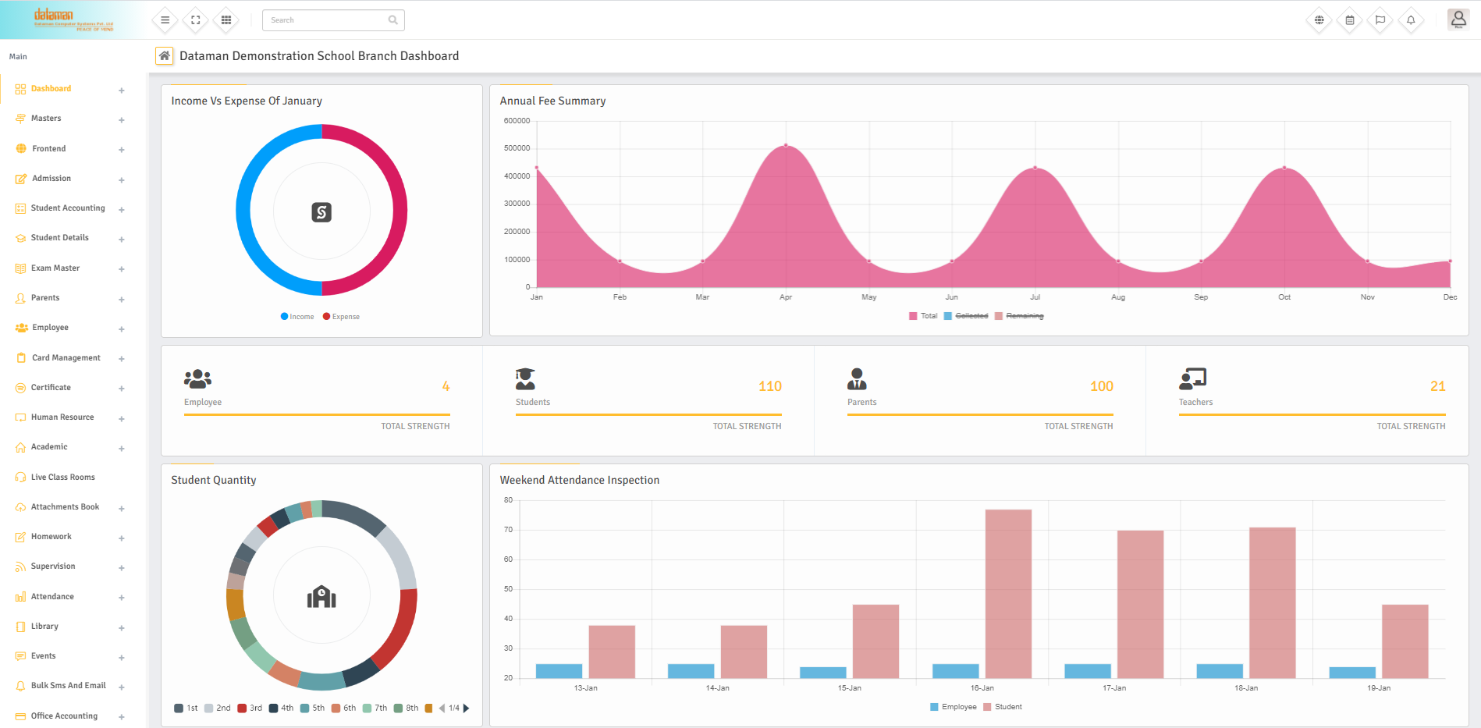
SCREENSHOT
Dashboard

Slide 13
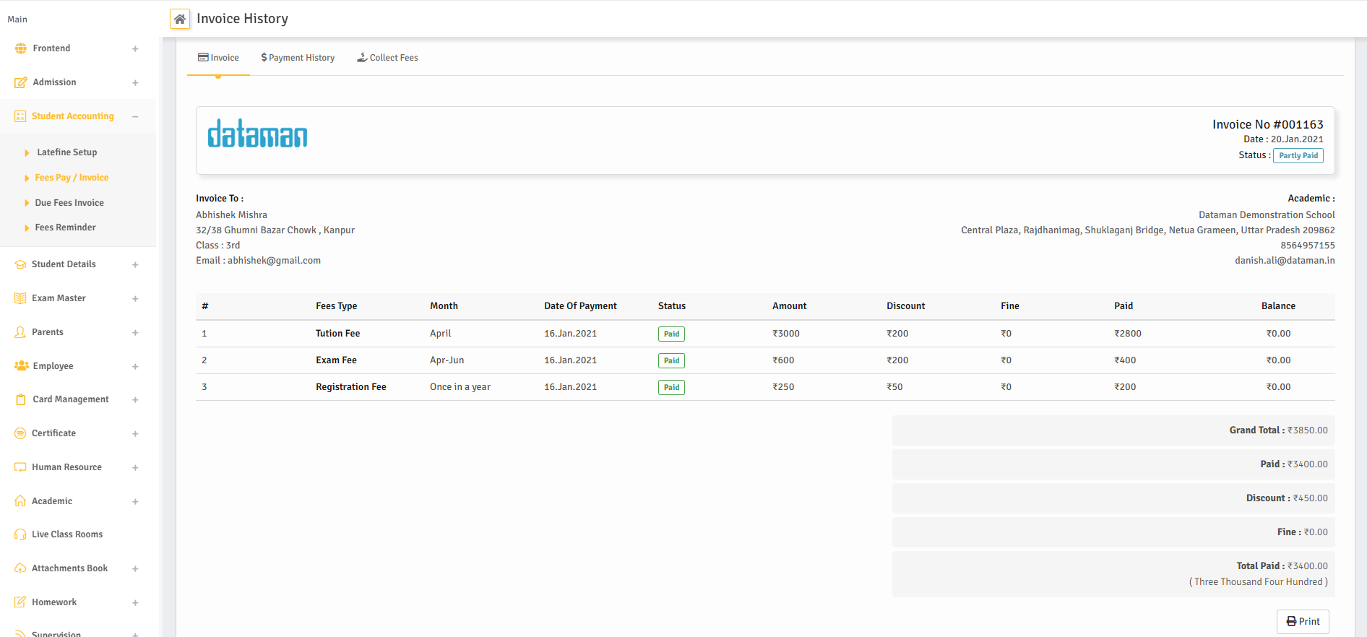
SCREENSHOT
Invoice History

Slide 14
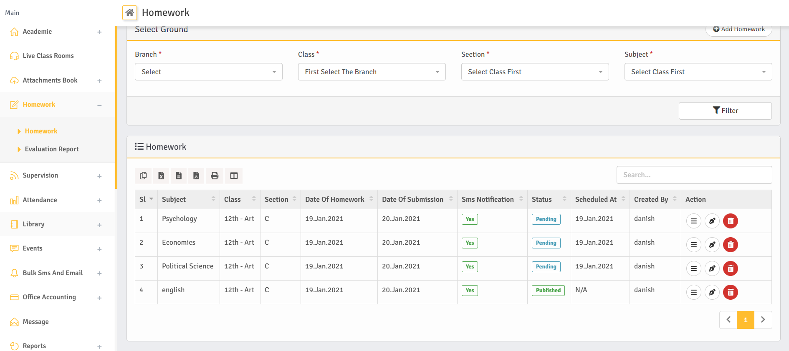
SCREENSHOT
Homework Screen

Slide 15
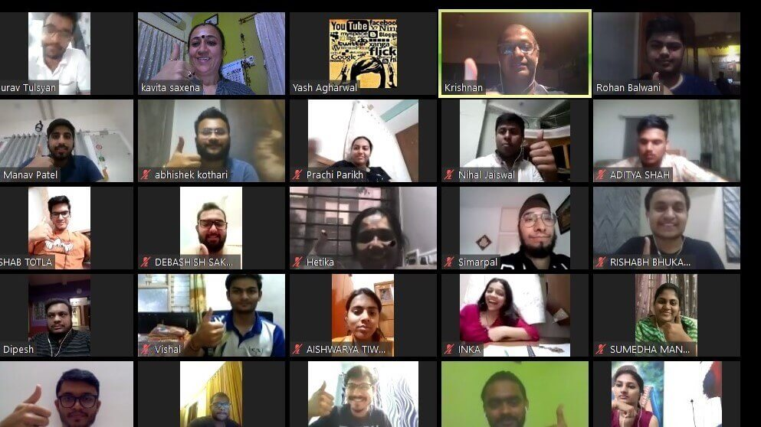
SCREENSHOT
Live Class Screen

Slide 16
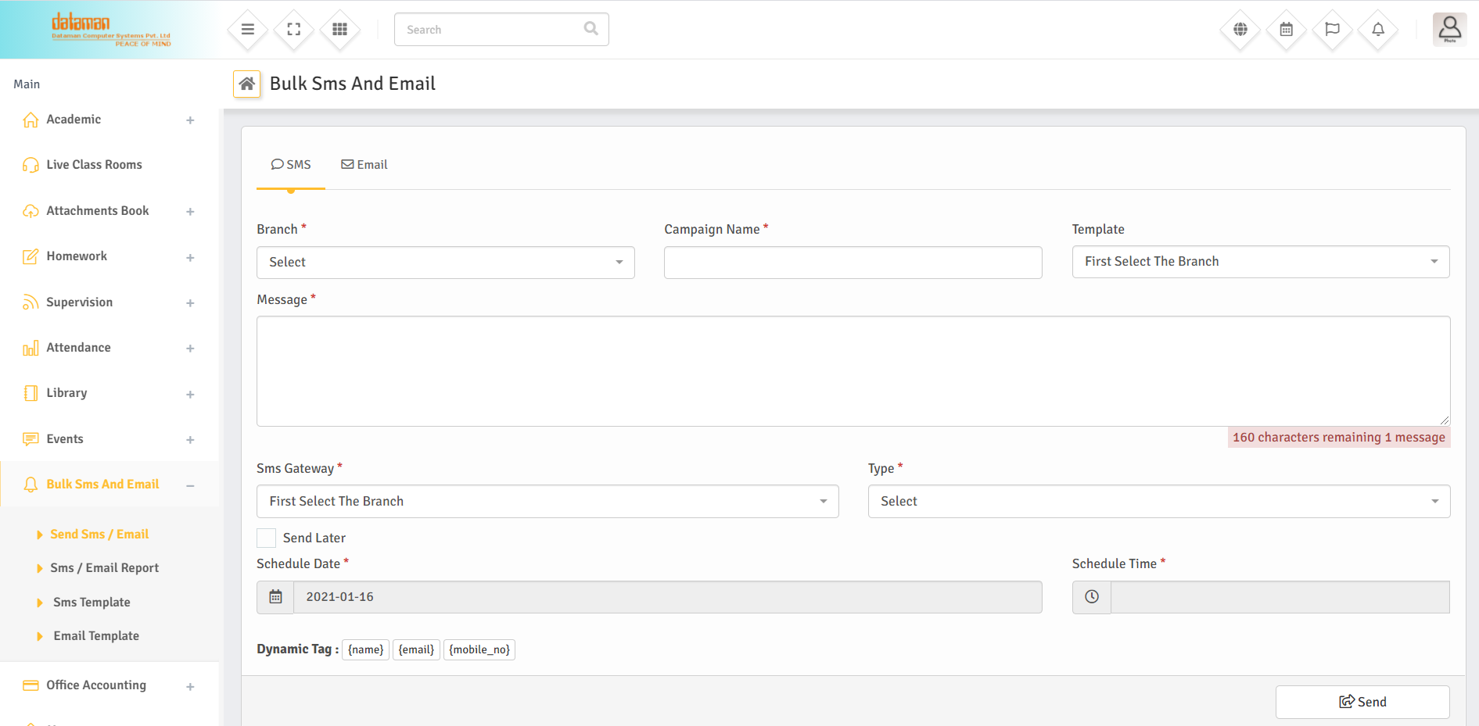
SCREENSHOT
Bulk SMS And Email

Slide 17
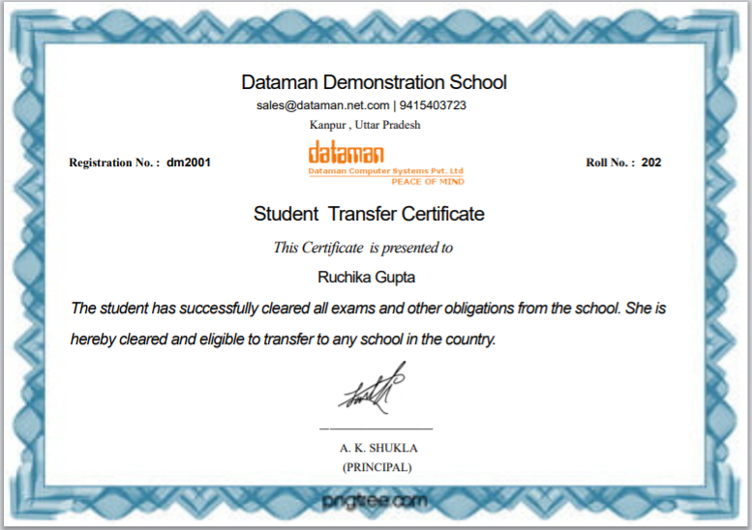
SCREENSHOT
Transfer Certificate

Slide 18
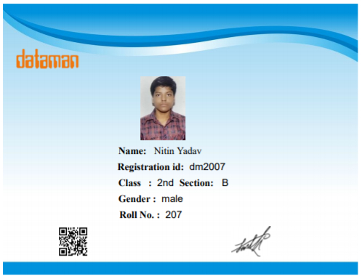
SCREENSHOT
Student Id Card

Slide 19
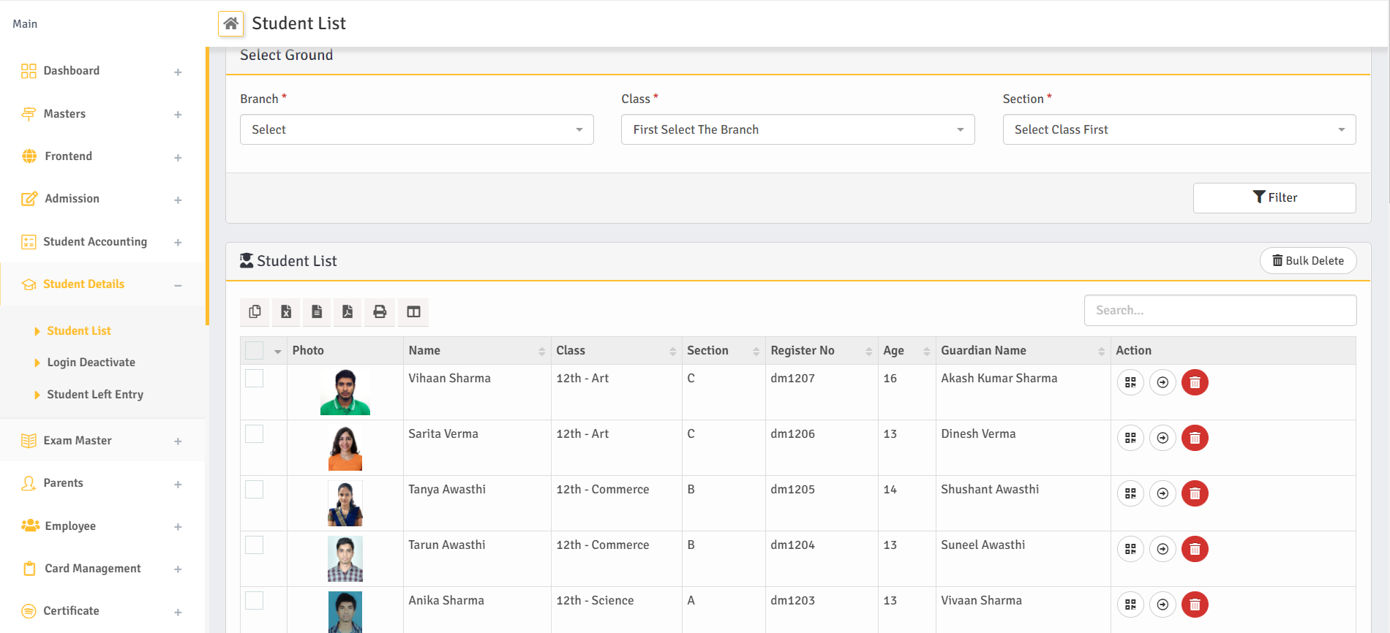
SCREENSHOT
Student List

